Slide 1
Error Detection and Correction in Digital Signal Processing using Cyclic Redundancy Check (CRC) Codes in PYTHON
RACHEL M D URK22EC1044

Slide 2
CONTENT
OBJECTIVE
INTRODUCTION
PRINCIPLE
EXPLANATION
CODE
OUTPUT
SIGNIFICANCE
RESULT

Slide 3
OBJECTIVE
The objective of this project is to explore error detection and correction techniques within the domain of digital signal processing (DSP) by implementing Cyclic Redundancy Check (CRC) codes using PYTHON. The project aims to investigate how CRC codes can be utilized to enhance the reliability of digital communication systems by detecting and possibly correcting errors introduced during data transmission. Through this endeavor, we seek to gain a deeper understanding of CRC algorithms, their implementation in PYTHON, and their effectiveness in ensuring data integrity in real-world scenarios. By simulating communication channels with varying levels of noise and distortion, we aim to analyze the performance of CRC codes in detecting errors and evaluate their ability to mitigate data corruption. Additionally, this project aims to provide insights into the practical application of error detection and correction techniques in DSP, contributing to the broader field of digital communications and signal processing research.

Slide 4
INTRODUCTION
Error detection and correction are pivotal in ensuring the reliability and integrity of data transmitted over communication channels, especially in the presence of noise and interference. Cyclic redundancy check (CRC) coding is an error-control coding technique for detecting errors that occur when transmitting a data frame. Unlike block or convolutional codes, CRC codes do not have a built-in error-correction capability. Cyclic Redundancy Check (CRC) codes are widely employed for this purpose due to their simplicity, effectiveness, and low computational overhead. In this project, we focus on implementing CRC codes in PYTHON, specifically within the context of digital signal processing (DSP) systems.

Slide 5
PRINCIPLE
Cyclic Redundancy Check (CRC) code
Cyclic redundancy check (CRC) coding is an error-control coding technique for detecting errors that occur when transmitting a data frame. Unlike block or convolutional codes, CRC codes do not have a built-in error-correction capability. Instead, when a communications system detects a CRC coding error in a received codeword, the receiver requests the sender to retransmit the codeword.
It works by performing a polynomial division of the data to be transmitted by a divisor polynomial, and the remainder of this division is the CRC code. This CRC code is then transmitted along with the data. At the receiving end, the same polynomial division is performed again, and if the new remainder is zero, the data is assumed to be error-free.

Slide 6
principle
This implementation uses a division-like process to calculate the CRC remainder. The data is padded with zeros to match the length of the divisor, and then the polynomial division is performed. The result of the division is the CRC remainder, which is then transmitted with the data. At the receiving end, the same polynomial division is performed again, and if the new remainder is zero, the data is assumed to be error-free.
The crc_check function can be used to check the received data for errors. It calculates the CRC remainder for the received data and compares it to the received CRC value. If they match, the data is assumed to be error-free, and if not, it means there are errors.
The strength of the CRC lies in the choice of the divisor polynomial. By selecting a polynomial that has a long cycle length, the CRC can detect a wide range of errors, including single-bit errors, burst errors, and errors that are caused by the effects of noise.
CRC is widely used in digital signal processing for error detection in data transmission. It is particularly useful in applications where a high level of reliability is required, such as in telecommunications, networking, and data storage.

Slide 7
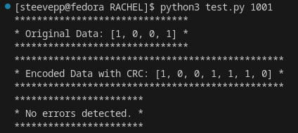
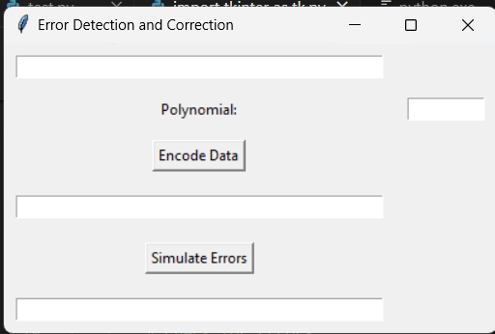
OUTPUT

Slide 8
THANK YOU

